Slide 1

ANKARA UNIVERSITY
Faculty of Engineering · Department of Computer Engineering
COM2058 · FINAL PROJECT
Work and Travel
Student Management System
A relational database-driven desktop application connecting students, agencies, U.S. employers and housing through a Microsoft SQL Server back-end.
Submission Date
Faik Yılmaz · 23291024
May 29, 2026
Furkan Duran · 22290579
Ahmet Can · 23291550
Supervisor: Department of Computer Engineering

Slide 2
Agenda
01
Problem & Project Overview
06
Java Client and SQL Server Connectivity
02
System Scope and Requirements
07
Application Screenshots
03
Entity-Relationship Model
08
Representative SQL Queries
04
Database Schema (Tables)
09
Conclusion and Future Work
05
Foreign Keys & Referential Integrity
WAT Management System · COM2058 Database Management Systems
2 / 18

Slide 3
What is Work and Travel?
A cultural-exchange program coordinated by four parties — and a paperwork challenge.
The Problem
Students
Agencies
Each year, thousands of students join the WAT program. Coordination between agencies, U.S. employers and housing providers is traditionally handled with spreadsheets and e-mail — a process that quickly breaks down.
University applicants
Consultancy partners
Employers
Housing
Our Solution
U.S. seasonal hirers
Accommodation near workplace
A centralised relational database backed by Microsoft SQL Server, accessed through a Java Swing desktop client. The schema enforces referential integrity; the client enforces business rules through JDBC transactions.
WAT Management System · COM2058 Database Management Systems
3 / 18

Slide 4
Scope & Functional Requirements
Eight requirements that drive the data model.
FR-1
FR-5
Authenticate students with university e-mail and password.
Let employers post multiple distinct job offers.
FR-2
FR-6
Bind each student to exactly one agency per WAT season.
Allow students to browse employers and apply through a bridge table.
FR-3
FR-7
Log every payment with amount, date and student reference.
Prevent a job from being filled by more than one student.
FR-4
FR-8
Maintain a 1:1 visa-process record per student (status, SEVIS, interview date).
Show a personal dashboard: visa, accepted job, assigned housing.
WAT Management System · COM2058 Database Management Systems
4 / 18

Slide 5
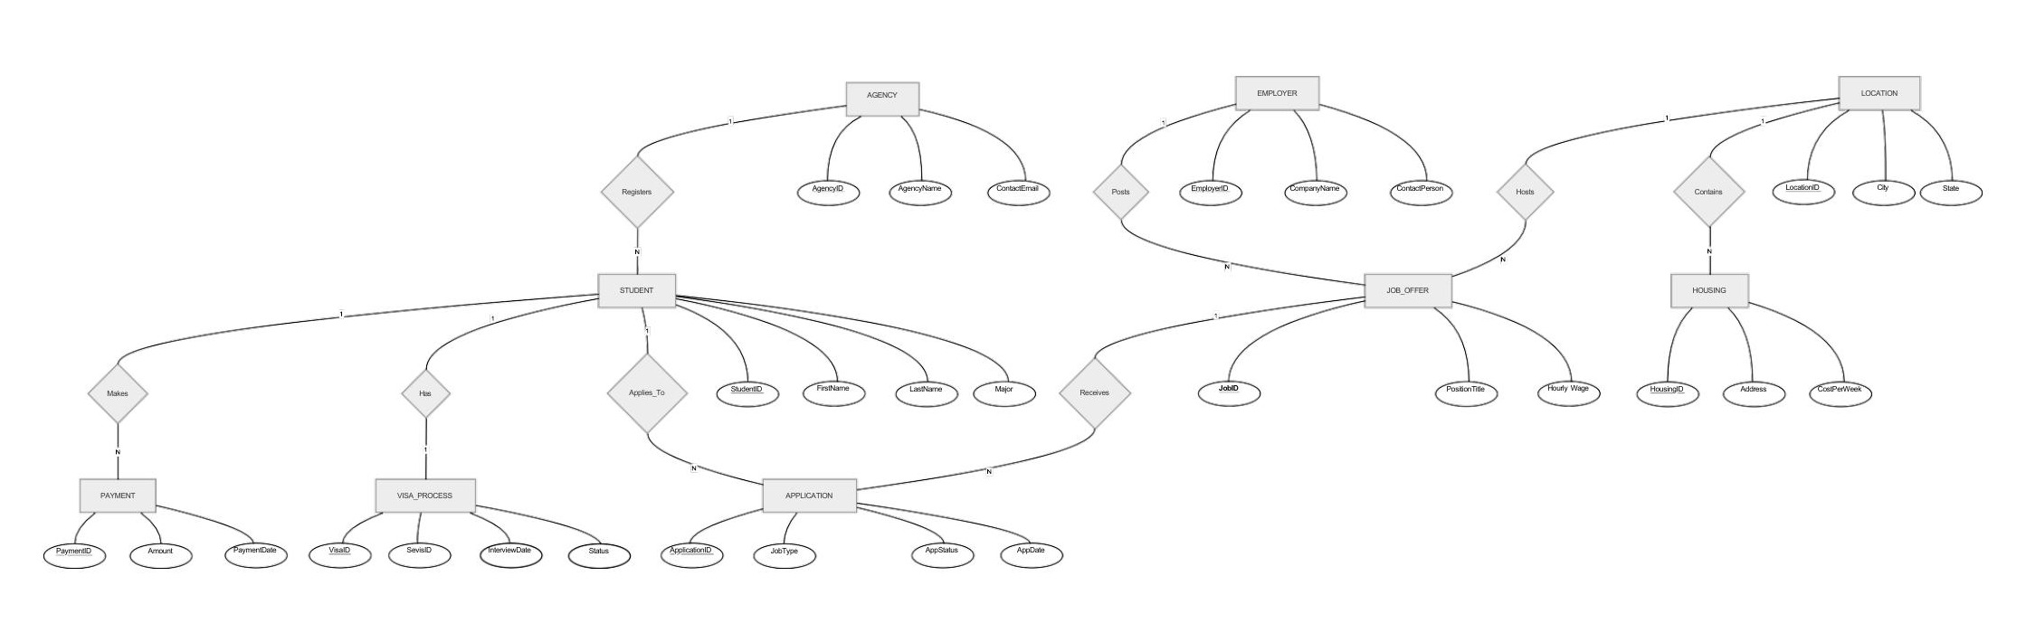
Entity-Relationship Model
Nine entities, seven named relationships, one bridge.
STUDENT, AGENCY, EMPLOYER, JOB_OFFER, LOCATION and HOUSING are the principal real-world entities. PAYMENT and VISA_PROCESS depend on STUDENT. APPLICATION is the bridge that resolves the many-to-many tie between STUDENT and JOB_OFFER.
WAT Management System · COM2058 Database Management Systems
5 / 18

Slide 6
Relationships & Cardinalities
From the ER diagram to the foreign keys.
Relationship | Entities | Cardinality | Meaning
Registers | AGENCY — STUDENT | 1 : N | An agency manages many students; a student joins one agency.
Makes | STUDENT — PAYMENT | 1 : N | A student may pay in multiple installments.
Has | STUDENT — VISA_PROCESS | 1 : 1 | Each student has exactly one visa record per season.
Applies_To | STUDENT — APPLICATION | 1 : N | A student may submit several applications.
Receives | JOB_OFFER — APPLICATION | 1 : N | A job offer can receive many applications.
Posts | EMPLOYER — JOB_OFFER | 1 : N | An employer publishes multiple positions.
Hosts | LOCATION — JOB_OFFER | 1 : N | A location may host multiple positions.
Contains | LOCATION — HOUSING | 1 : N | A location contains many housing options.
WAT Management System · COM2058 Database Management Systems
6 / 18

Slide 7
Database Schema · 9 Tables
Each principal entity becomes one normalised relation.
AGENCY
STUDENT
EMPLOYER
AgencyID (PK), AgencyName, ContactEmail
StudentID (PK), FirstName, LastName, Major, AgencyID (FK), email, password
EmployerID (PK), CompanyName, ContactPerson
LOCATION
JOB_OFFER
HOUSING
LocationID (PK), City, State
JobID (PK), PositionTitle, HourlyWage, EmployerID (FK), LocationID (FK)
HousingID (PK), Address, CostPerWeek, LocationID (FK)
VISA_PROCESS
PAYMENT
APPLICATION
VisaID (PK), SevisID, InterviewDate, Status, StudentID (FK)
PaymentID (PK), Amount, PaymentDate, StudentID (FK)
ApplicationID (PK), AppDate, AppStatus, JobType, StudentID (FK), JobID (FK)
WAT Management System · COM2058 Database Management Systems
7 / 18

Slide 8
Table Detail · STUDENT and JOB_OFFER
Two central tables, with primary and foreign keys highlighted.
STUDENT
JOB_OFFER
Attribute | Type | Constraint
StudentID | INT | PRIMARY KEY
FirstName | VARCHAR(50) | —
LastName | VARCHAR(50) | —
Major | VARCHAR(100) | —
AgencyID | INT | FK → AGENCY
email | VARCHAR(100) | Login
password | VARCHAR(50) | Login
Attribute | Type | Constraint
JobID | INT | PRIMARY KEY
PositionTitle | VARCHAR(100) | —
HourlyWage | DECIMAL(5,2) | USD per hour
EmployerID | INT | FK → EMPLOYER
LocationID | INT | FK → LOCATION
Why two foreign keys on JOB_OFFER? A position must belong to a real employer (EmployerID → EMPLOYER) and sit in a real U.S. location (LocationID → LOCATION). These constraints stop orphan rows from sneaking in through the Java client.
WAT Management System · COM2058 Database Management Systems
8 / 18

Slide 9
Foreign Keys & Referential Integrity
Every reference resolves to an existing parent row.
STUDENT.AgencyID
→
AGENCY.AgencyID
JOB_OFFER.EmployerID
→
EMPLOYER.EmployerID
JOB_OFFER.LocationID
→
LOCATION.LocationID
HOUSING.LocationID
→
LOCATION.LocationID
VISA_PROCESS.StudentID
→
STUDENT.StudentID
PAYMENT.StudentID
→
STUDENT.StudentID
APPLICATION.StudentID
→
STUDENT.StudentID
APPLICATION.JobID
→
JOB_OFFER.JobID
Deleting an AGENCY, EMPLOYER or LOCATION while dependent rows exist is rejected by SQL Server — preventing orphan records and inconsistent application state.
WAT Management System · COM2058 Database Management Systems
9 / 18

Slide 10
Implementation Stack
Microsoft SQL Server + Java Swing over JDBC.
Database engine
Microsoft SQL Server Express 2022
JDBC connection string
DDL / DML
Transact-SQL (T-SQL)
String URL =
"jdbc:sqlserver://localhost\\SQLEXPRESS:1433;" +
"databaseName=WAT_Student_Management_System;" +
"encrypt=true;" +
"trustServerCertificate=true;";
Class.forName(
"com.microsoft.sqlserver.jdbc.SQLServerDriver");
return DriverManager.getConnection(URL, USER, PASS);
Client
Java 17 · Swing
Driver
Microsoft JDBC Driver for SQL Server
Build
Apache Maven
IDE
IntelliJ IDEA
Three-layer architecture
ui
model
db
Swing windows (MainFrame)
POJOs (Student, Employer, JobOffer)
JDBC + queries (DatabaseConnection, WAT_Student_Management_System)
WAT Management System · COM2058 Database Management Systems
10 / 18

Slide 11
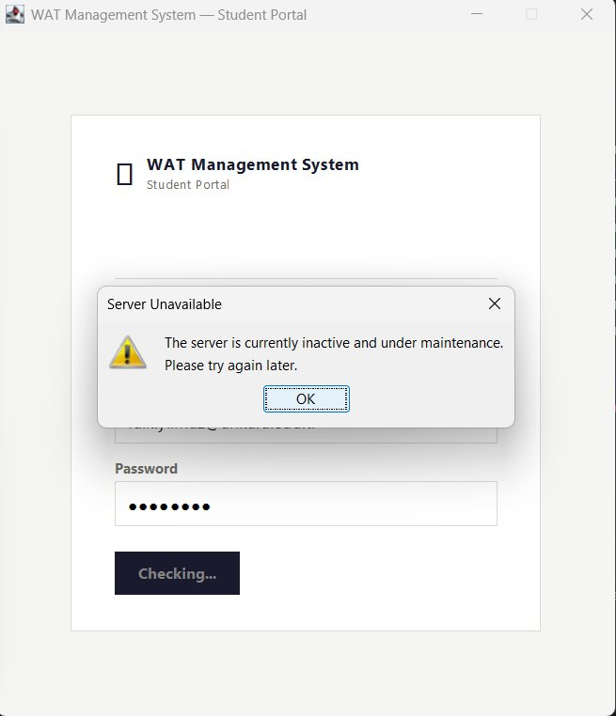
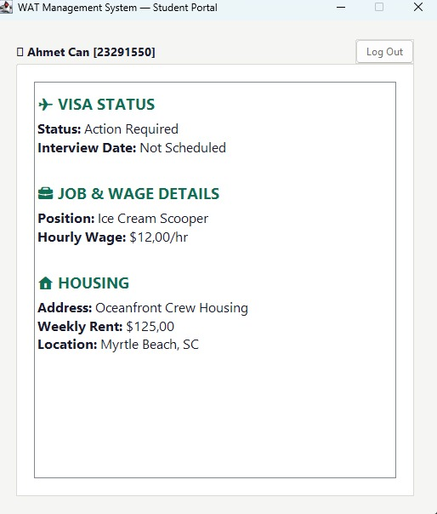
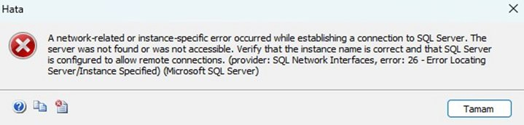
Application Screenshots
Both states of the client and the underlying SSMS error.
Figure 1 · Login screen — 'Server Unavailable' dialog
Figure 2 · Personal dashboard after successful login
Figure 3 · SSMS — equivalent server-down error
Triggered by isServerAvailable() when the JDBC probe times out — UI degrades gracefully instead of crashing.
Student 23291550 (Ahmet Can) — visa, job and housing rows pulled live by the five-table LEFT JOIN in Q4.
SQL Server Management Studio surfaces the same network/instance error that the client guards against.
WAT Management System · COM2058 Database Management Systems
11 / 18

Slide 12
Query 1 · Students With a Pending Visa
JOIN of STUDENT and VISA_PROCESS on StudentID.
SELECT s.StudentID,
s.FirstName,
s.LastName,
v.SevisID,
v.InterviewDate
FROM STUDENT s
JOIN VISA_PROCESS v
ON s.StudentID = v.StudentID
WHERE v.Status = 'Pending'
ORDER BY v.InterviewDate;
StudentID | FirstName | LastName | SevisID | InterviewDate
23291002 | Burak | Demir | N002000002 | 2026-04-10
23291005 | Emre | Yildiz | N002000005 | 2026-04-12
22290579 | Furkan | Duran | N001234568 | 2026-04-18
23291001 | Ayse | Kaya | N002000008 | 2026-04-25
23291004 | Deniz | Celik | N002000004 | 2026-04-28
23291007 | Gokhan | Aydin | N002000007 | 2026-05-02
23291009 | Irem | Arslan | N002000009 | 2026-05-05
23291012 | Mustafa | Cetinkaya | N002000012 | 2026-05-10
23291015 | Pelin | Bulut | N002000015 | 2026-05-12
23291018 | Tolga | Yavuz | N002000018 | 2026-05-15
Use case
Used by agencies to prepare interview-day briefings and to remind students whose consulate appointment is closest.
WAT Management System · COM2058 Database Management Systems
12 / 18

Slide 13
Query 2 · Total Payments per Agency
Aggregating with SUM and GROUP BY across three tables.
SELECT a.AgencyName,
COUNT(DISTINCT s.StudentID) AS NumStudents,
SUM(p.Amount) AS TotalCollected
FROM AGENCY a
JOIN STUDENT s ON s.AgencyID = a.AgencyID
JOIN PAYMENT p ON p.StudentID = s.StudentID
GROUP BY a.AgencyName
ORDER BY TotalCollected DESC;
AgencyName | NumStudents | TotalCollected
Success | 3 | $2,000.00
CampusEDU | 3 | $2,000.00
Global Vizyon | 3 | $2,000.00
Armada Grandee | 3 | $1,750.00
StudyZONE | 3 | $1,750.00
United Towers | 3 | $1,750.00
Westline International | 3 | $1,750.00
Öztek International | 3 | $1,750.00
YERO | 2 | $1,250.00
Advice Yurtdışı Eğitim | 2 | $1,000.00
Use case
Operations dashboard: financial overview per agency, surfacing both reach (NumStudents) and revenue (TotalCollected).
WAT Management System · COM2058 Database Management Systems
13 / 18

Slide 14
Query 3 · Best Hourly Wage in Each State
MAX with GROUP BY; helps applicants pick a destination.
SELECT l.State,
MAX(j.HourlyWage) AS TopWage,
COUNT(j.JobID) AS NumJobs
FROM JOB_OFFER j
JOIN LOCATION l
ON j.LocationID = l.LocationID
GROUP BY l.State
ORDER BY TopWage DESC;
State | TopWage | NumJobs
TN | $18.50 | 2
MA | $18.00 | 4
FL | $17.00 | 8
OR | $17.00 | 3
WI | $17.00 | 5
NJ | $16.50 | 4
MD | $16.00 | 6
MI | $16.00 | 2
MN | $16.00 | 2
OH | $16.00 | 4
SC | $15.50 | 9
TX | $15.50 | 1
$18.50
Highest hourly wage on offer · Server position, Nashville TN
WAT Management System · COM2058 Database Management Systems
14 / 18

Slide 15
Query 4 · Personal Process Dashboard
Five-table LEFT JOIN that powers the Java client dashboard.
SELECT v.Status AS VisaStatus,
v.InterviewDate,
j.PositionTitle,
j.HourlyWage,
h.Address AS HousingAddress,
h.CostPerWeek AS HousingCost,
l.City, l.State
FROM STUDENT s
LEFT JOIN VISA_PROCESS v ON s.StudentID = v.StudentID
LEFT JOIN APPLICATION a ON s.StudentID = a.StudentID
LEFT JOIN JOB_OFFER j ON a.JobID = j.JobID
LEFT JOIN LOCATION l ON j.LocationID = l.LocationID
LEFT JOIN HOUSING h ON l.LocationID = h.LocationID
WHERE s.StudentID = 23291550; -- Ahmet Can
Ahmet Can · 23291550
✈ VISA STATUS
Status: Action Required
Interview Date: Not Scheduled
💼 JOB & WAGE
Position: Ice Cream Scooper
Hourly Wage: $12.00 / hr
🏠 HOUSING
Address: Oceanfront Crew Housing
Weekly Rent: $125.00
Location: Myrtle Beach, SC
WAT Management System · COM2058 Database Management Systems
15 / 18

Slide 16
Query 5 · Open Positions (NOT EXISTS)
Subquery to express the absence of an accepted application.
SELECT j.JobID,
j.PositionTitle,
j.HourlyWage,
e.CompanyName,
l.City, l.State
FROM JOB_OFFER j
JOIN EMPLOYER e ON j.EmployerID = e.EmployerID
JOIN LOCATION l ON j.LocationID = l.LocationID
WHERE NOT EXISTS (
SELECT 1 FROM APPLICATION a
WHERE a.JobID = j.JobID
AND a.AppStatus = 'Accepted'
)
ORDER BY j.HourlyWage DESC;
Top 5 open positions (of ≈ 45)
JobID | Position | Wage | Employer | City
151 | Line Cook | $18.00 | The Lobster Pot | Provincetown
104 | Prep Cook | $17.00 | Stimulus Coffee + Bakery | Pacific City
121 | Kitchen Prep | $17.00 | The Lobster Pot | Provincetown
137 | Front Desk Agent | $17.00 | Marriott Resort | Destin
148 | Server | $17.00 | Dave & Buster's | Nashville
60
≈45
15
Use case
Job Offers in the system
Still open for application
Already accepted
Powers the employer screen — students see only jobs that have not been claimed yet, and the NOT EXISTS subquery scales cleanly as APPLICATION grows.
WAT Management System · COM2058 Database Management Systems
16 / 18

Slide 17
Conclusion & Future Work
What we delivered, what we learned, what comes next.
Delivered
Learned
Next
Normalized 9-table schema on SQL Server
60+ realistic job offers, 25 students, 25 visas
Java Swing client (login → apply → dashboard)
Transactional job-application logic in JDBC
Bridge tables (APPLICATION) handle N:M cleanly
FKs catch invalid input before it reaches the data
LEFT JOIN drives a great dashboard query
Server-availability checks make UI resilient
Web front-end on Spring Boot
Role-based admin / student views
Trigger-level enforcement of FR-7
Seasonal pricing for HOUSING records
Thank you — questions welcome.
WAT Management System · COM2058 Database Management Systems
17 / 18

Slide 18
Thank you
Work and Travel Student Management System
Faik Yılmaz · Furkan Duran · Ahmet Can
Ankara University · Department of Computer Engineering · COM2058 · 2026

